Slide 1
Prosthetic part

Slide 2
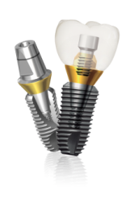
Abutment level impression Ⅰ
Combi abutment/Dual abutment – Multi units

Slide 3
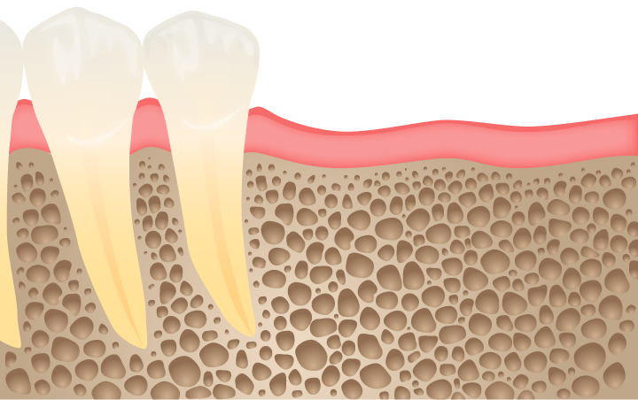
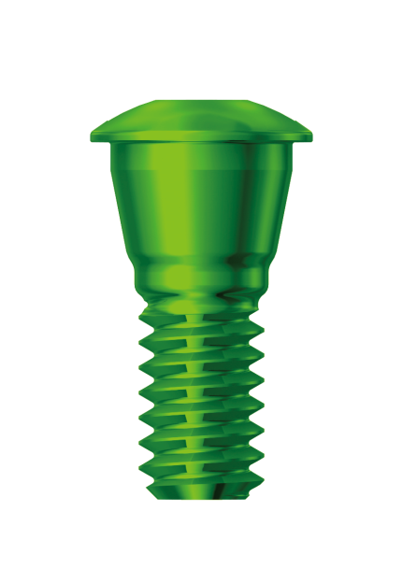
Prosthetic part
Remove Cover screw

Slide 4
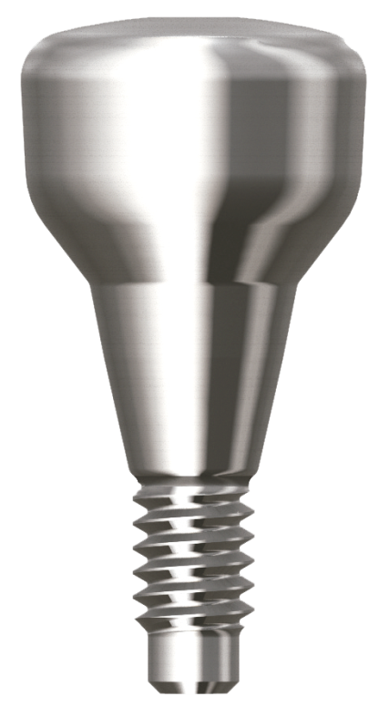
Prosthetic part
Remove Healing abutment

Slide 5
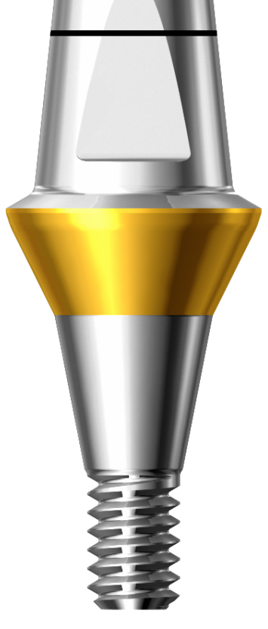
Prosthetic part
Select suitable Combi abutment, then tighten it to 25~30N.cm
[Re-tighten after 15 minutes]

Slide 6
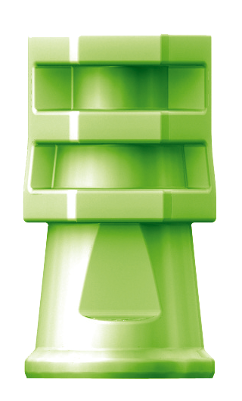
Prosthetic part
Connect Impression coping over the Abutment firmly
[Snap-on mechanism]

Slide 7
Prosthetic part
Take Impression [closed tray]

Slide 8
Prosthetic part
Take Impression [closed tray]

Slide 9
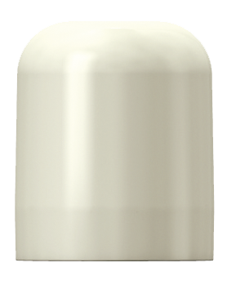
Prosthetic part
Fabricate provisional restoration, or use Comfort cap

Slide 10
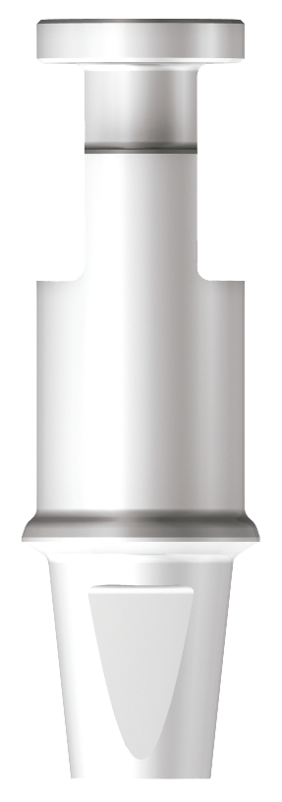
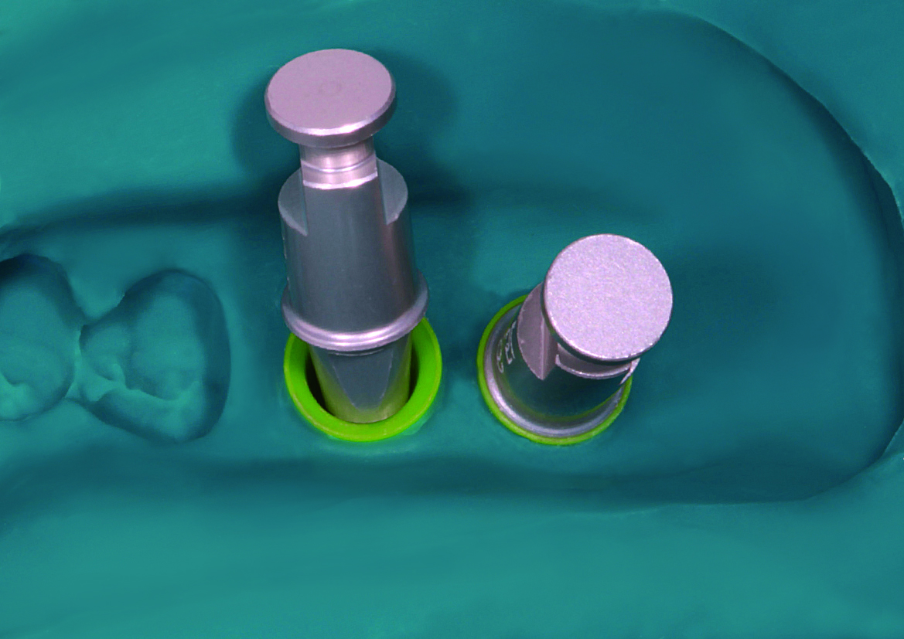
Prosthetic part
Insert Lab analog into Impression coping
[Match flat side of both analog & coping]

Slide 11
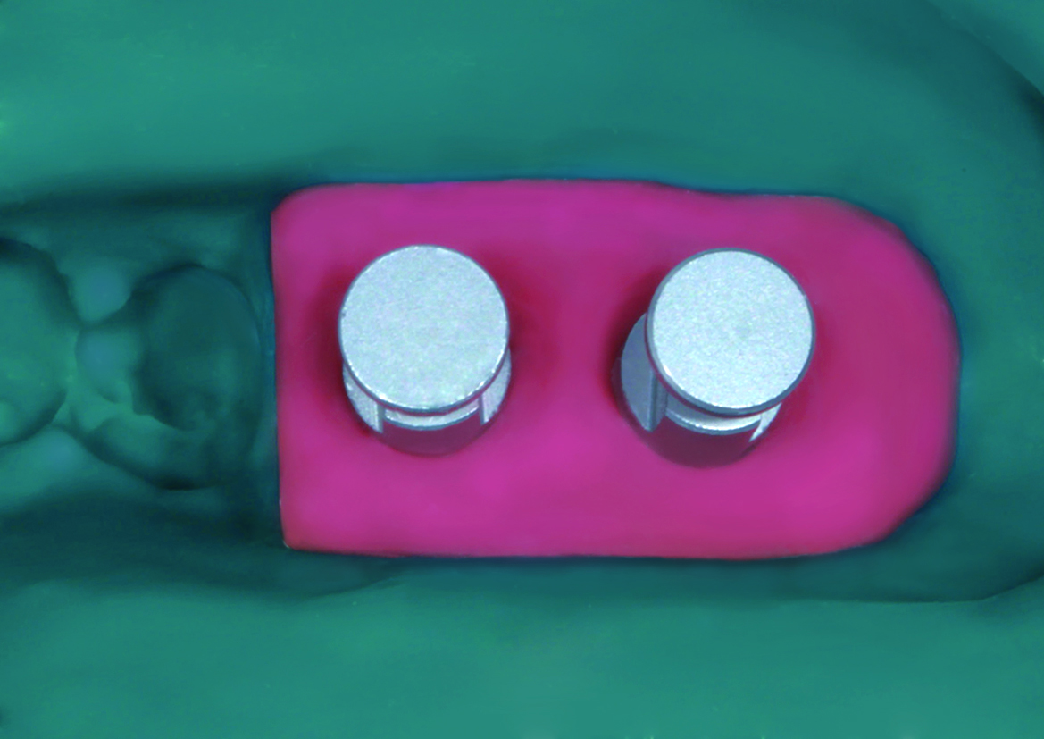
Prosthetic part
Fabricate soft tissue model

Slide 12
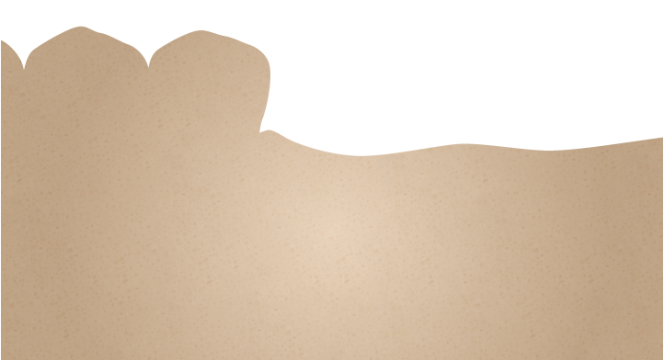
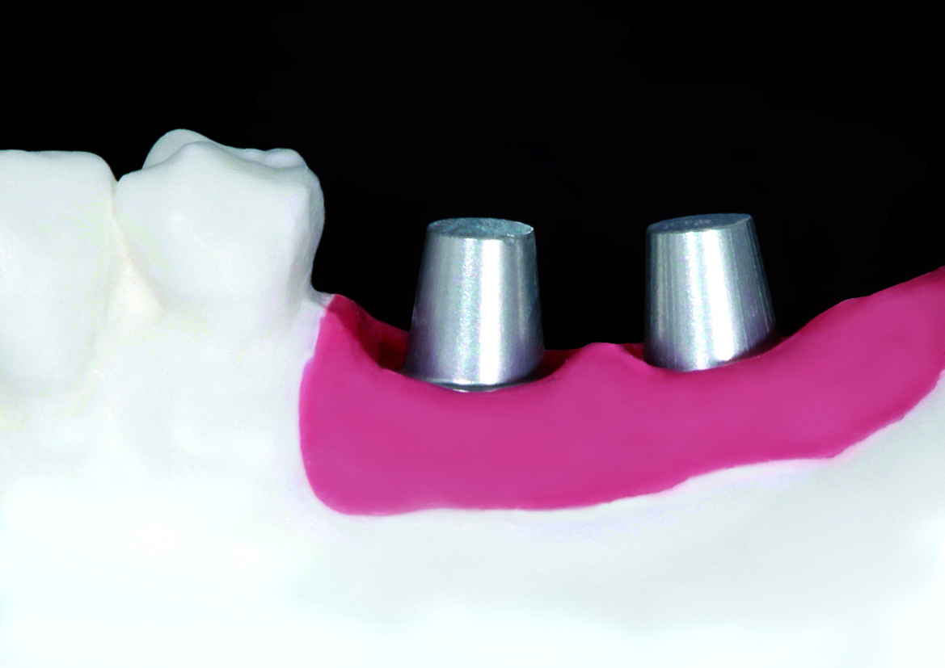
Prosthetic part
Fabricate master cast

Slide 13
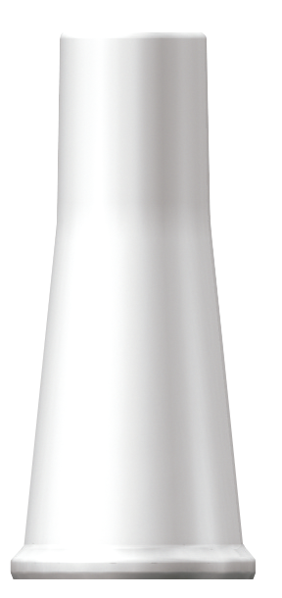
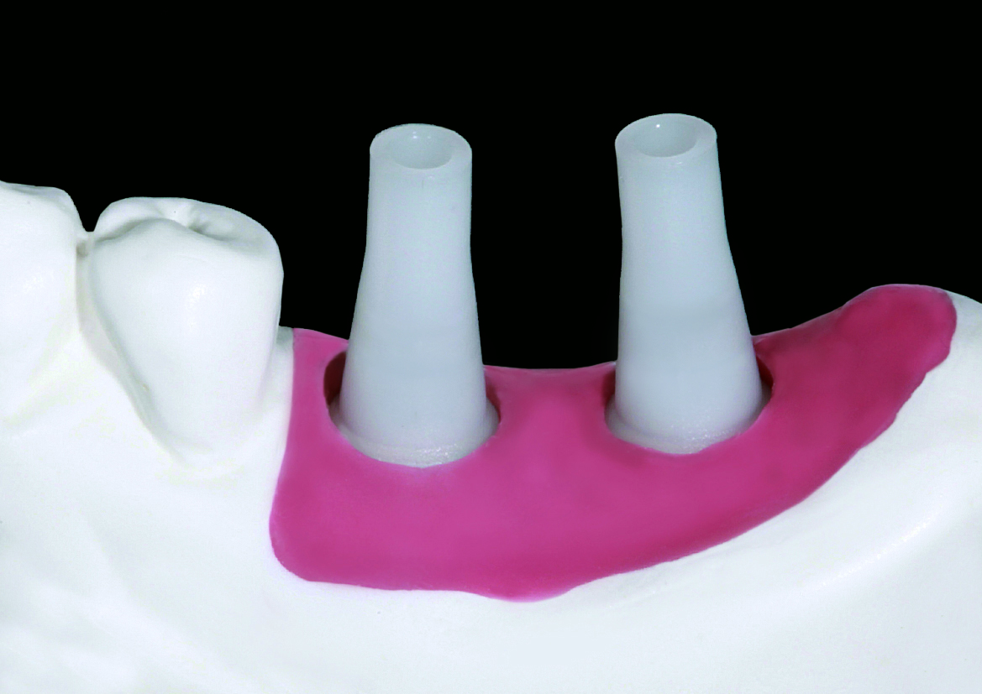
Prosthetic part
PFM prosthesis:
Seat Burn-out cylinder securely
into Lab analog

Slide 14
Prosthetic part
Wax-up

Slide 15
Prosthetic part
Cut-back

Slide 16
Prosthetic part
Metal framework

Slide 17
Prosthetic part
Opaque

Slide 18
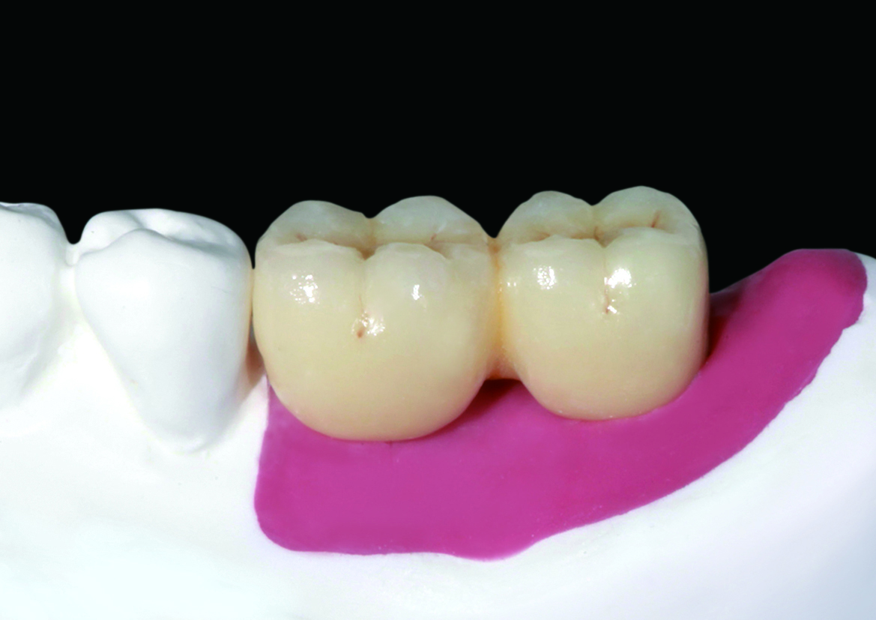
Prosthetic part
Porcelain build-up

Slide 19
Prosthetic part
Before delivery of final prosthesis

Slide 20
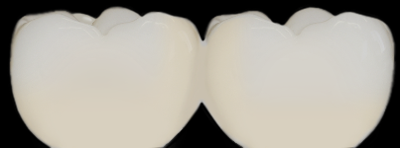
Prosthetic part
Delivery of final prosthesis

Slide 21
Prosthetic part
Zirconia prosthesis:
Scanning of Lab analogs and adjacent teeth on master cast

Slide 22
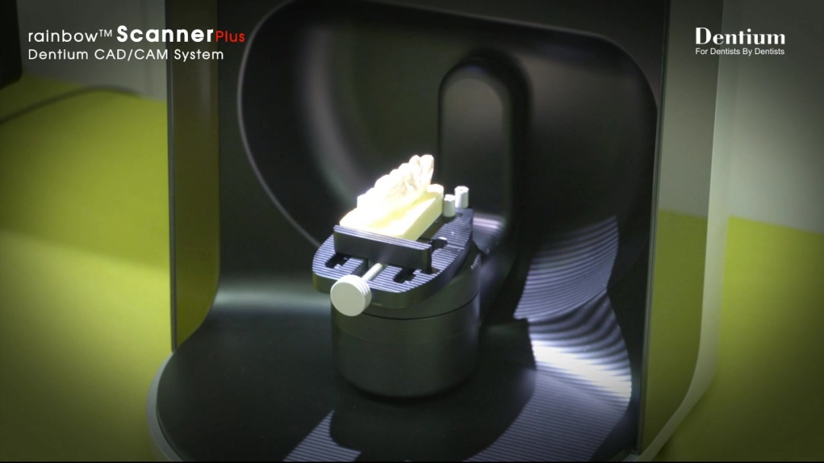
Prosthetic part
Scanning of Lab analogs and adjacent teeth on master cast

Slide 23
Prosthetic part
Wax-up
Cut-back

Slide 24
Prosthetic part
Zirconia framework

Slide 25
Prosthetic part
Porcelain build-up

Slide 26
Prosthetic part
Before delivery of final prosthesis

Slide 27
Prosthetic part
Delivery of final prosthesis

Slide 28
Abutment level impression Ⅱ
Screw abutment – PFM/PFG multi units

Slide 29
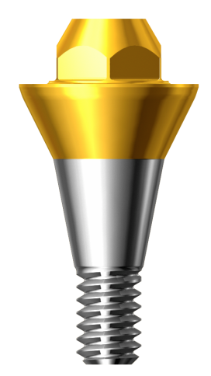
Prosthetic part
Screw abutment with delivery holder

Slide 30
Prosthetic part
Select and seat appropriate
Screw abutment with delivery holder

Slide 31
Prosthetic part
After insertion, tighten it with
Ratchet adapter
[Tighten it to 25~30N.cm then
Re-tighten after 15minutes]

Slide 32
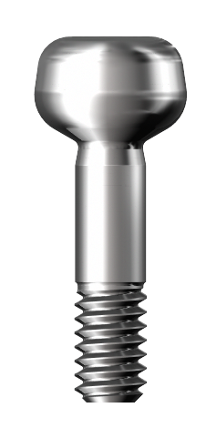
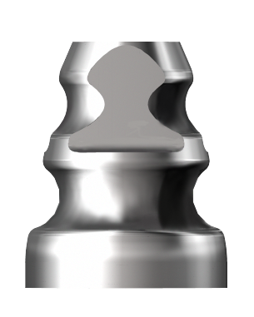
Prosthetic part
Seat Impression coping on Screw abutment

Slide 33
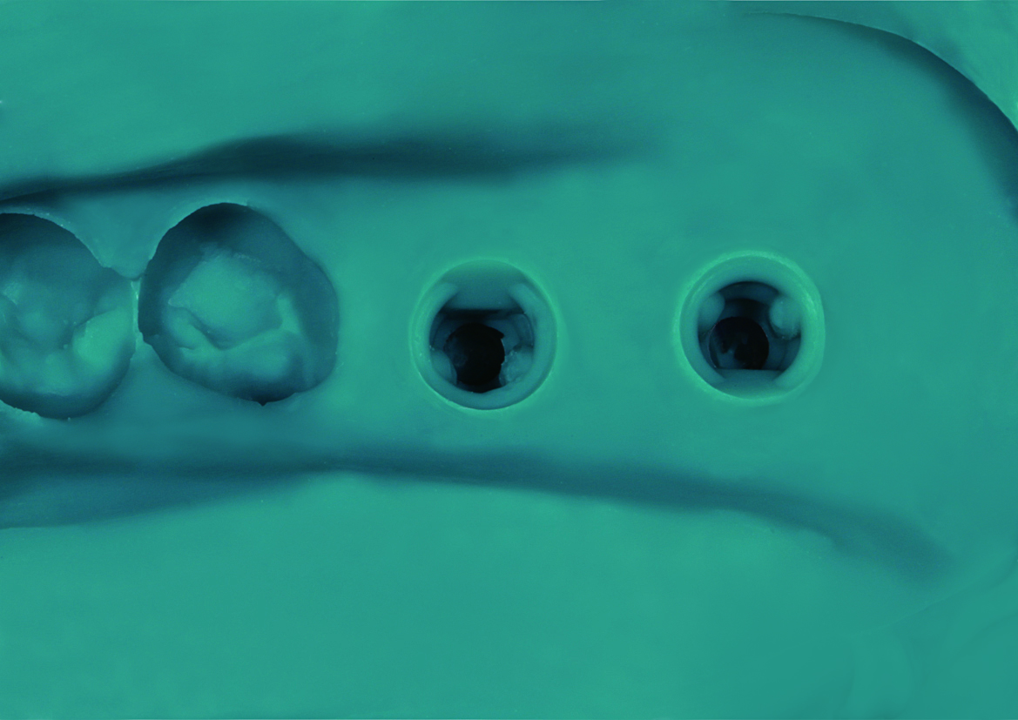
Prosthetic part
Take impression (closed tray)

Slide 34
Prosthetic part
Seat comfort cap on the Screw abutment

Slide 35
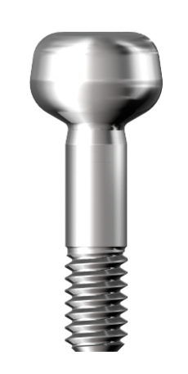
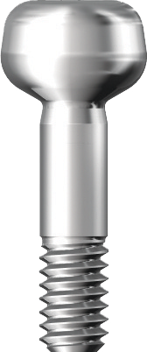
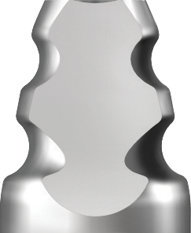
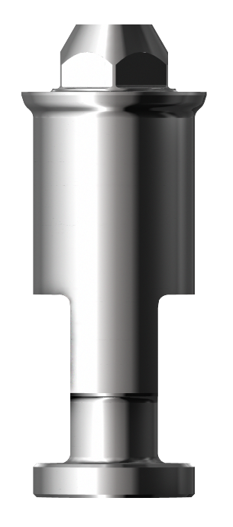
Prosthetic part
Remove the impression coping from oral cavity
and connect it with analog firmly

Slide 36
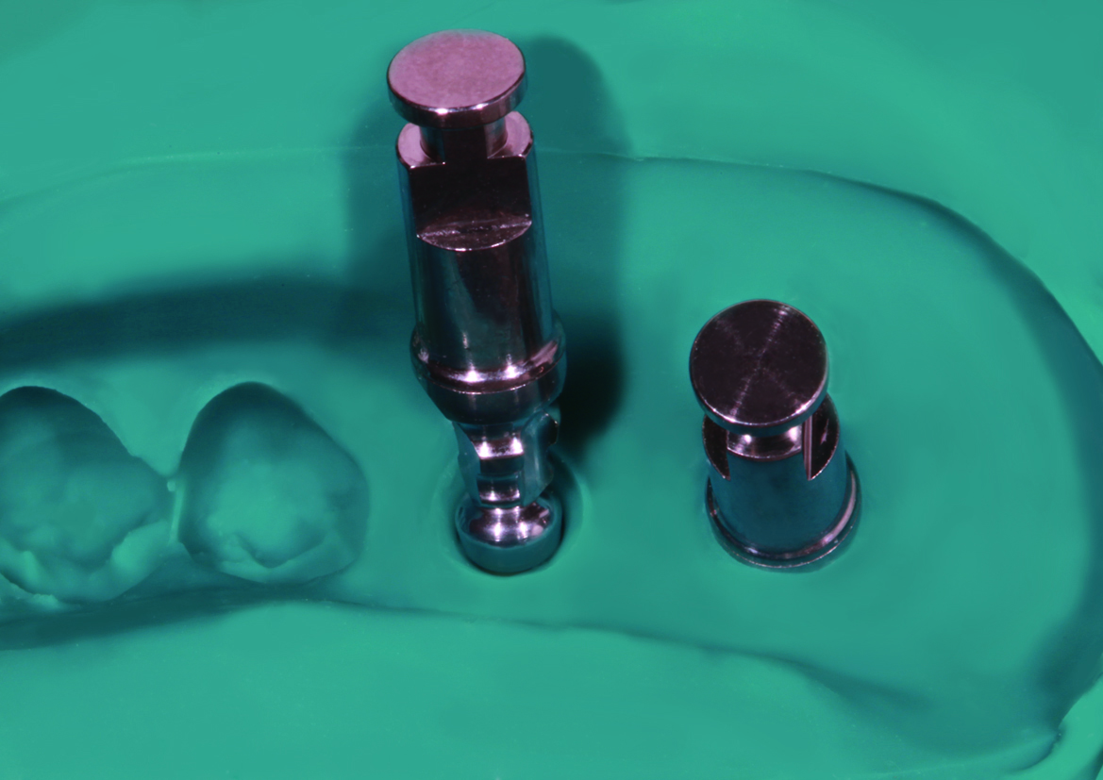
Prosthetic part
Insert the connected Impression coping
and Analog into the impression

Slide 37
Prosthetic part
Fabricate soft tissue model

Slide 38
Prosthetic part
Fabricate master cast

Slide 39
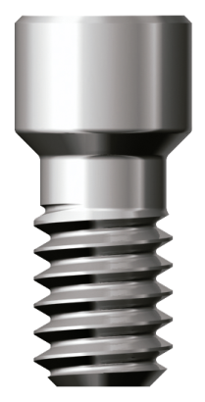
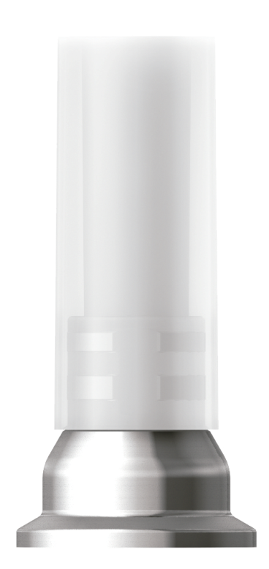
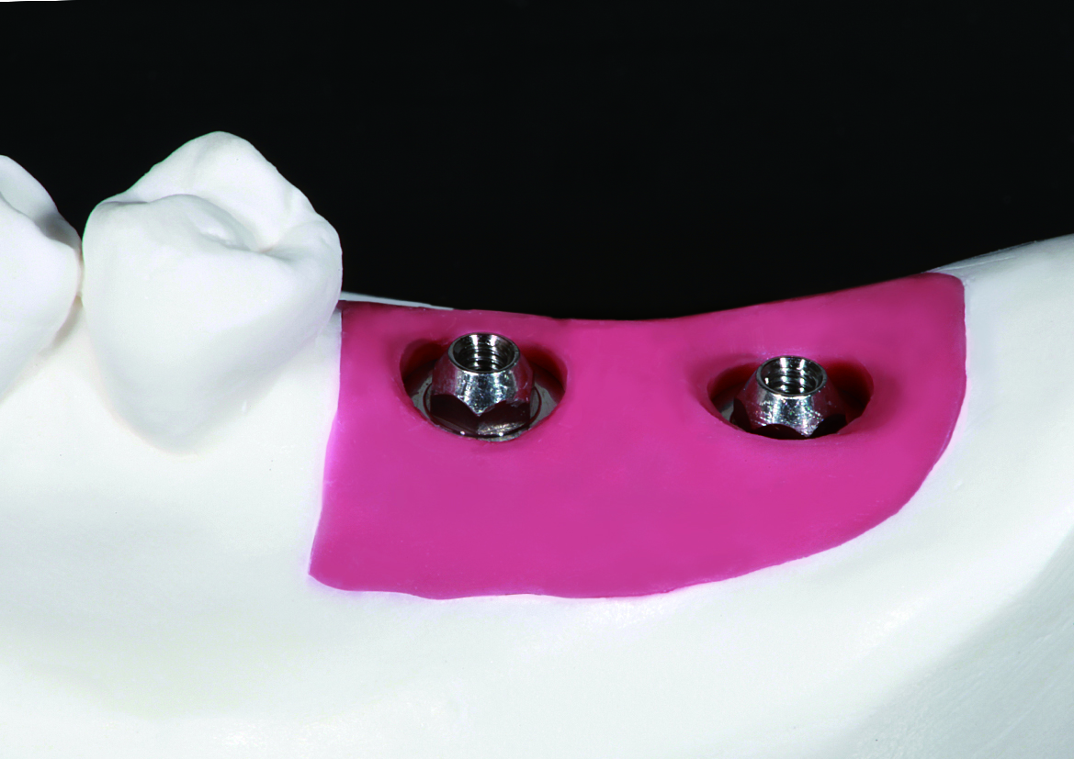
Prosthetic part
Seat the Gold-cylinder on the Screw
abutment Analog
[Tighten it to 10N.cm with
Ti-Retaining screw]

Slide 40
Prosthetic part
Consider the distance of opposing teeth,
modify cylinder to its proper height if needed

Slide 41
Prosthetic part
Wax-up

Slide 42
Prosthetic part
Cut-back

Slide 43
Prosthetic part
Completed gold framework

Slide 44
Prosthetic part
Opaque

Slide 45
Prosthetic part
Porcelain build-up

Slide 46
Prosthetic part
Final prosthesis
[Tighten it to 10N.cm with Ti-Retaining screw]

Slide 47
Prosthetic part
Delivery of final prosthesis

Slide 48
Fixture level impression Ⅰ
Dual abutment/Dual-milling abutment
Transfer type

Slide 49
Prosthetic part
Remove Cover screw

Slide 50
Prosthetic part
Remove Healing abutment

Slide 51
Prosthetic part
Insert Impression coping (transfer type) into Fixture

Slide 52
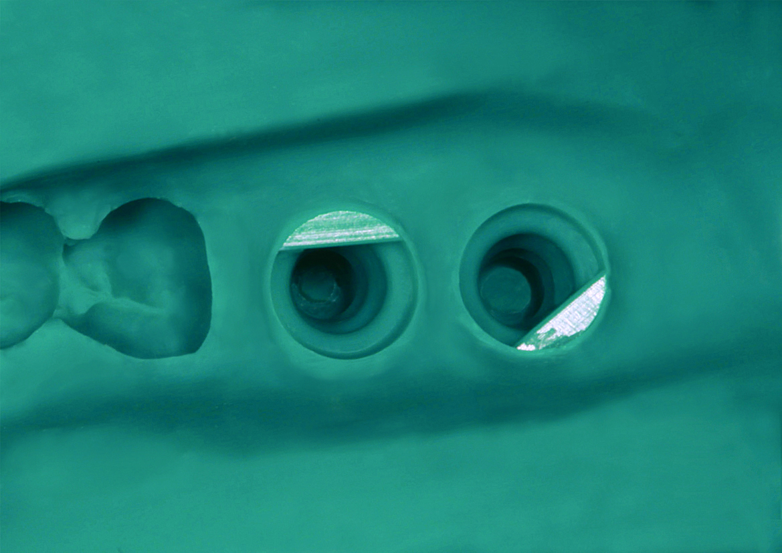
Prosthetic part
Take Impression [closed tray]

Slide 53
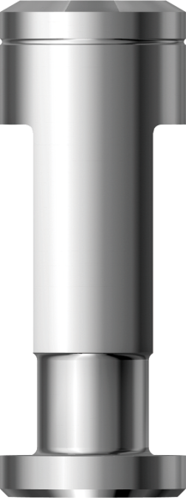
Prosthetic part
Insert Lab analog into Impression coping
[Match flat side of both analog & coping]

Slide 54
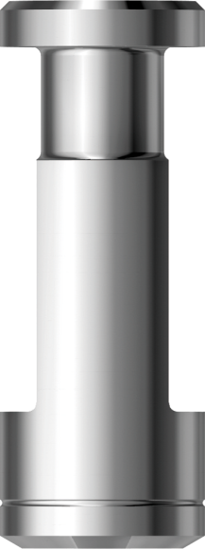
Prosthetic part
Fabricate soft tissue model

Slide 55
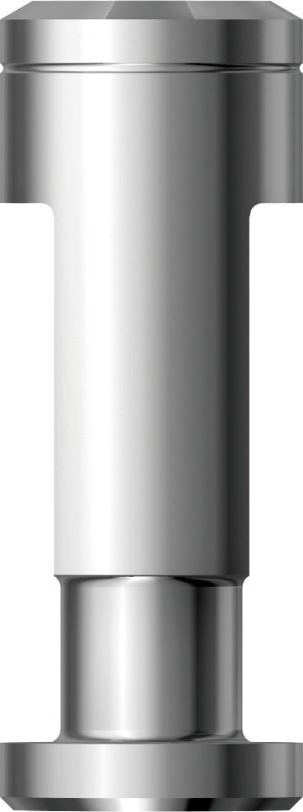
Prosthetic part
Fabricate master cast

Slide 56
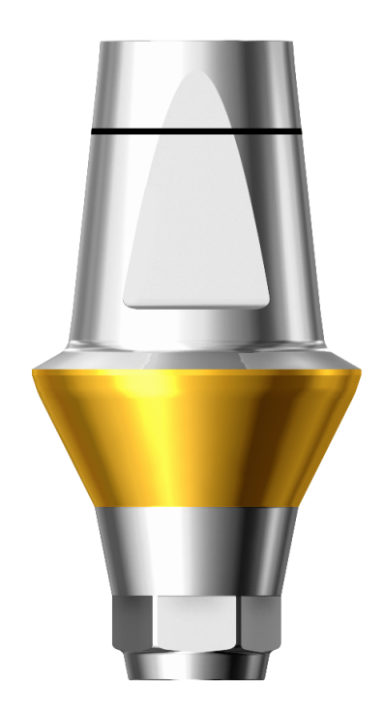
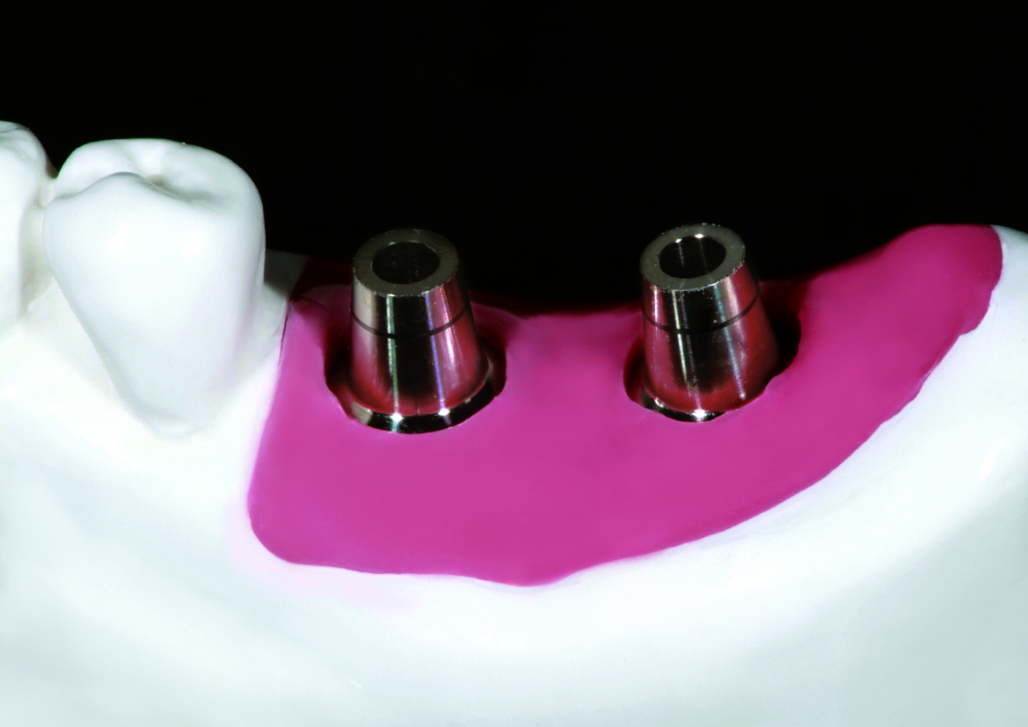
Prosthetic part
Select abutment with proper diameter and gingival height

Slide 57
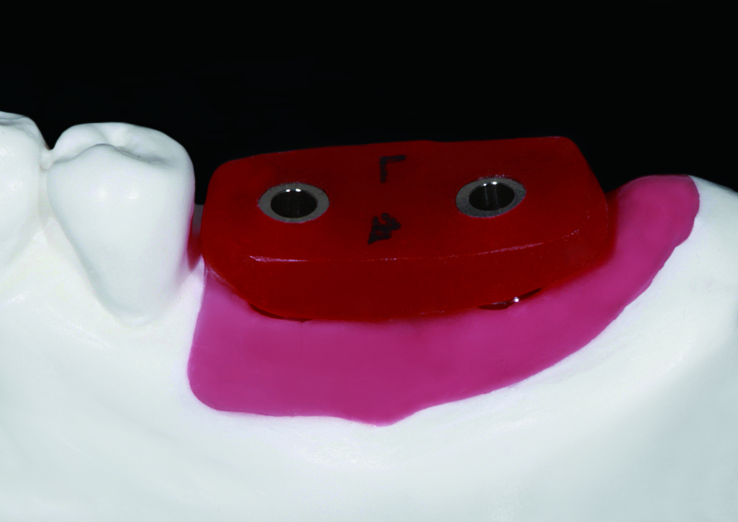
Prosthetic part
Fabricate positioning jig

Slide 58
Prosthetic part
Scanning of Lab analogs and adjacent teeth on master cast

Slide 59
Prosthetic part
Wax-up
Cut-back

Slide 60
Prosthetic part
Zirconia framework

Slide 61
Prosthetic part
Porcelain build-up

Slide 62
Prosthetic part
Abutment tightening with positioning jig
[Tighten it to 25~30N.cm and Re-tighten after 15 minutes]

Slide 63
Prosthetic part
Delivery of final prosthesis

Slide 64
Fixture level impression Ⅱ
Dual abutment/Dual-milling abutment
Pick-up type

Slide 65
Prosthetic part
Remove Cover screw

Slide 66
Prosthetic part
Remove Healing abutment

Slide 67
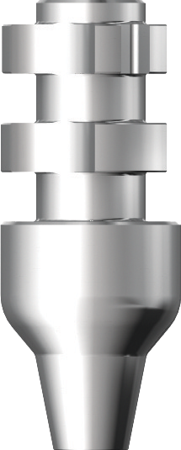
Prosthetic part
Insert Impression coping (pick-up)
into Fixture

Slide 68
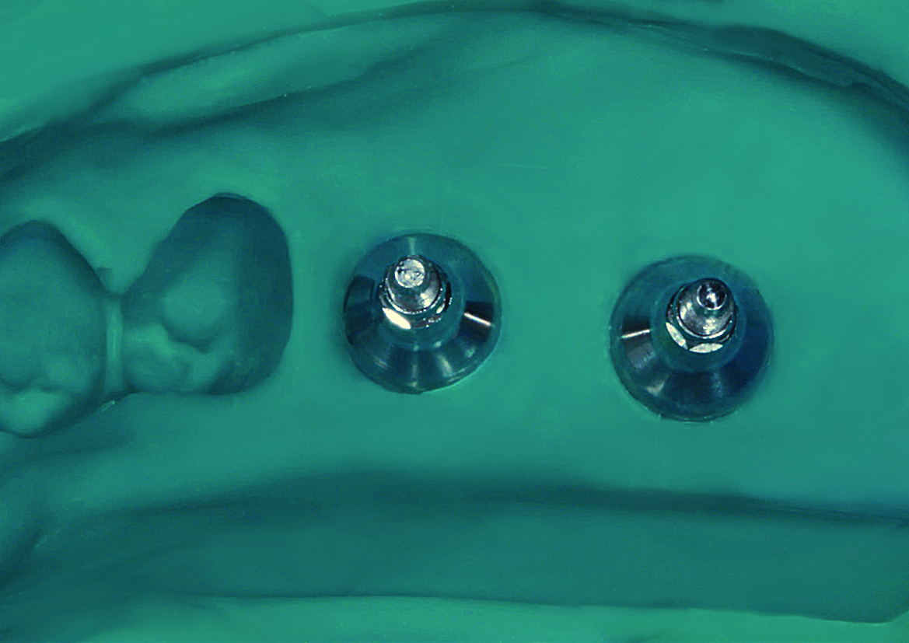
Prosthetic part
Take impression [open tray]

Slide 69
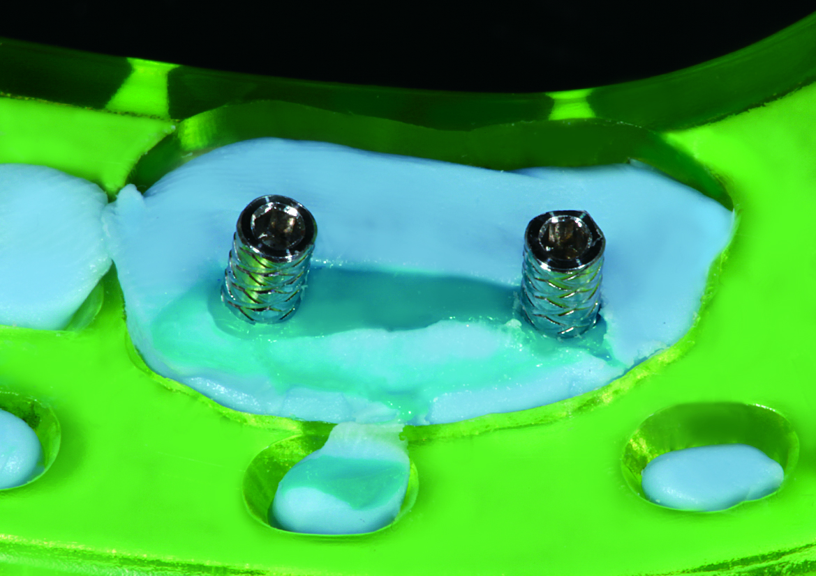
Prosthetic part
Unscrew Impression coping screw
before removing the impression tray

Slide 70
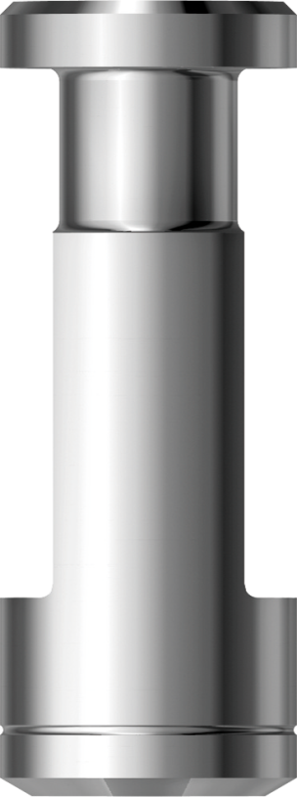
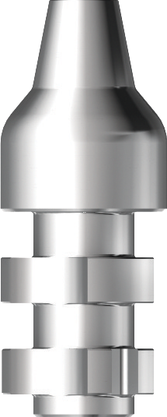
Prosthetic part
Fabricate soft tissue model

Slide 71
Prosthetic part
Fabricate master cast

Slide 72
Prosthetic part
Select abutment with proper diameter and gingival height

Slide 73
Prosthetic part
Fabricate positioning jig

Slide 74
Prosthetic part
Scanning of Lab analogs and adjacent teeth on master cast

Slide 75
Prosthetic part
Wax-up
Cut-back

Slide 76
Prosthetic part
Zirconia framework

Slide 77
Prosthetic part
Porcelain build-up

Slide 78
Prosthetic part
Abutment tightening with positioning jig
[Tighten it to 25~30N.cm and Re-tighten after 15 minutes]
Delivery of final prosthesis

Slide 79
Fixture level impression Ⅲ
Angled abutment
Transfer type

Slide 80
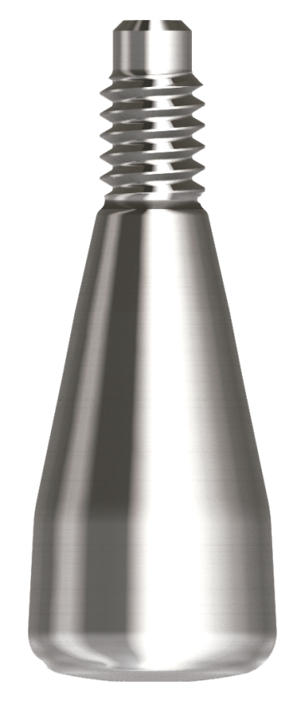
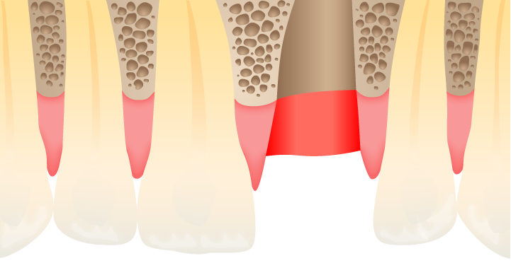
Prosthetic part
Remove Healing abutment

Slide 81
Prosthetic part
Connect Impression coping

Slide 82
Prosthetic part
Connect Impression coping

Slide 83
Prosthetic part
Take impression [closed tray]

Slide 84
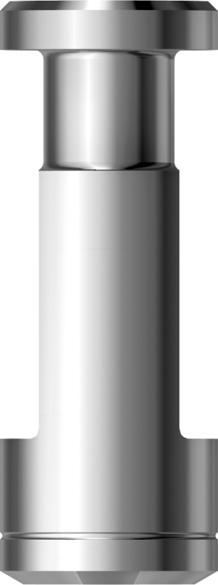
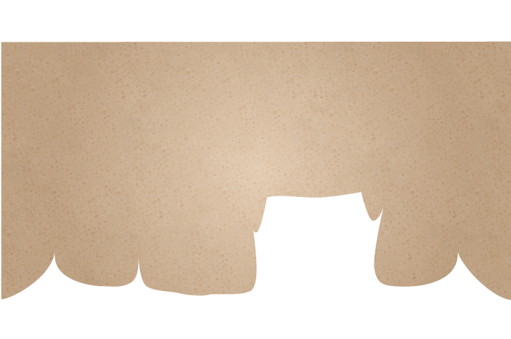
Prosthetic part
Fabricate master cast

Slide 85
Prosthetic part
Select proper Angled abutment

Slide 86
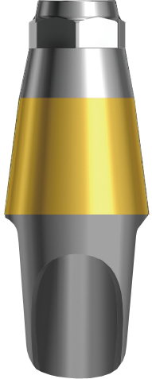
Prosthetic part
Fabricate positioning jig

Slide 87
Prosthetic part
Wax-up

Slide 88
Prosthetic part
Cut back

Slide 89
Prosthetic part
Completed Metal framework

Slide 90
Prosthetic part
Opaque

Slide 91
Prosthetic part
Porcelain build-up

Slide 92
Prosthetic part
Abutment tightening with positioning jig
[Tighten it to 25~30N.cm and Re-tighten after 15 minutes]

Slide 93
Prosthetic part
Delivery of final prosthesis

